Slide 1



FOOD SERVICE Application CAPSTONE PROJECT
-presentation By
Ashutosh Kumar Ashim Aakash Roy

Slide 2
WHY BUILD A FOOD SERVICE APP
Age of digitization
Demand post COVID-19
Enhance the customer convenience and comfort
Supports small and local restaurants as well

Slide 3
Features
CUSTOMER:
Customer can add or delete their favourite dish/items
Customer can view/update their profile, upload profile picture and much more
Customer can make online payment via Razor Pay API
Customer can search restaurant
VENDOR:
Vendors can host their restaurant by adding/deleting/updating restaurants and items details
Vendors just have to pack the ordered items delivery will be provided by us

Slide 4












TECHNOLOGIES IMPLEMENTED
FRONT-END
BACK-END
MISCELLANEOUS

Slide 5
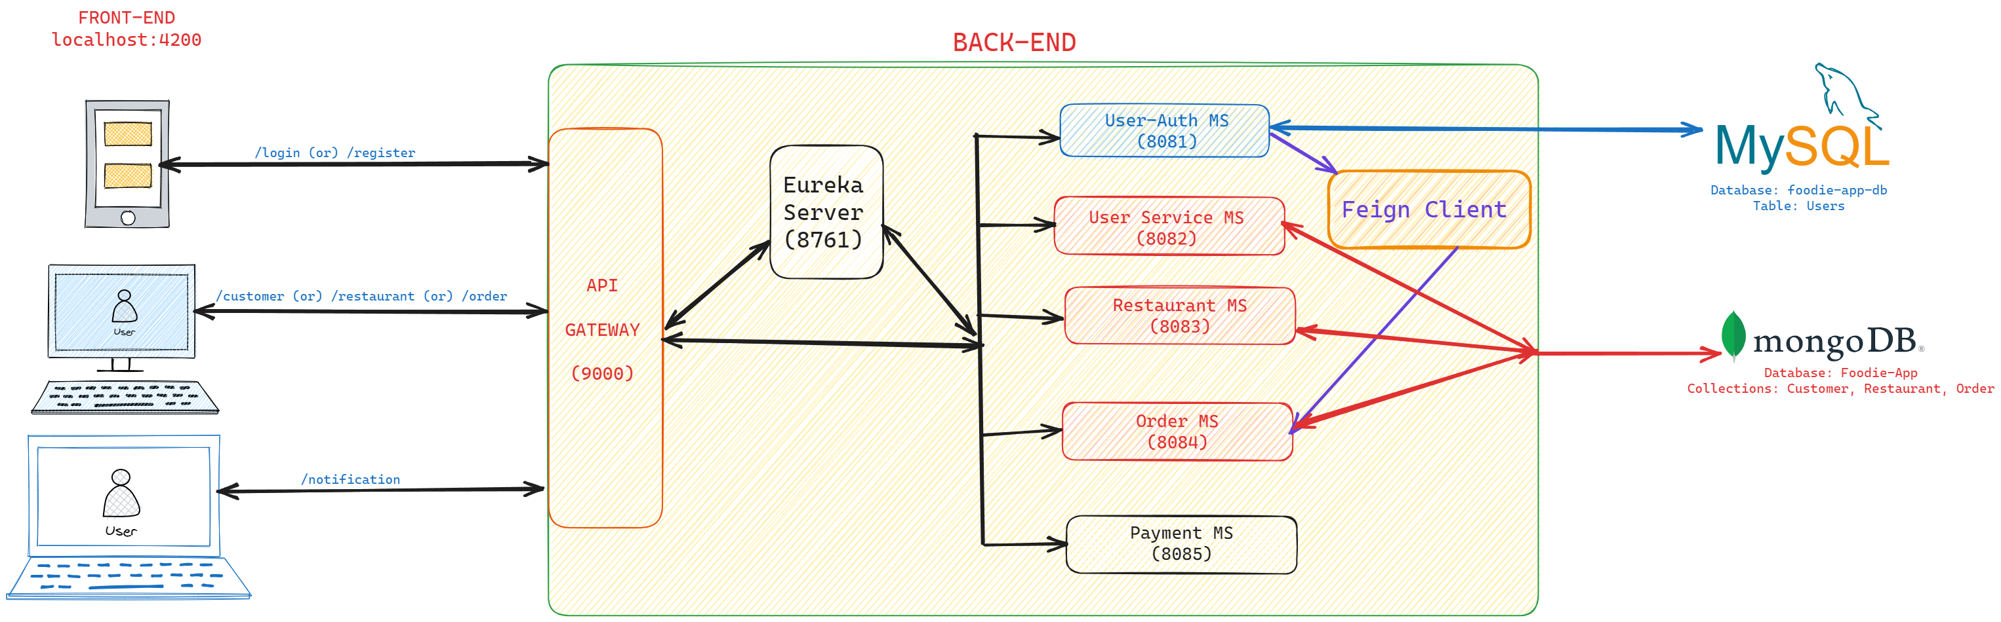
ARCHITECTURE DIAGRAM

Slide 6
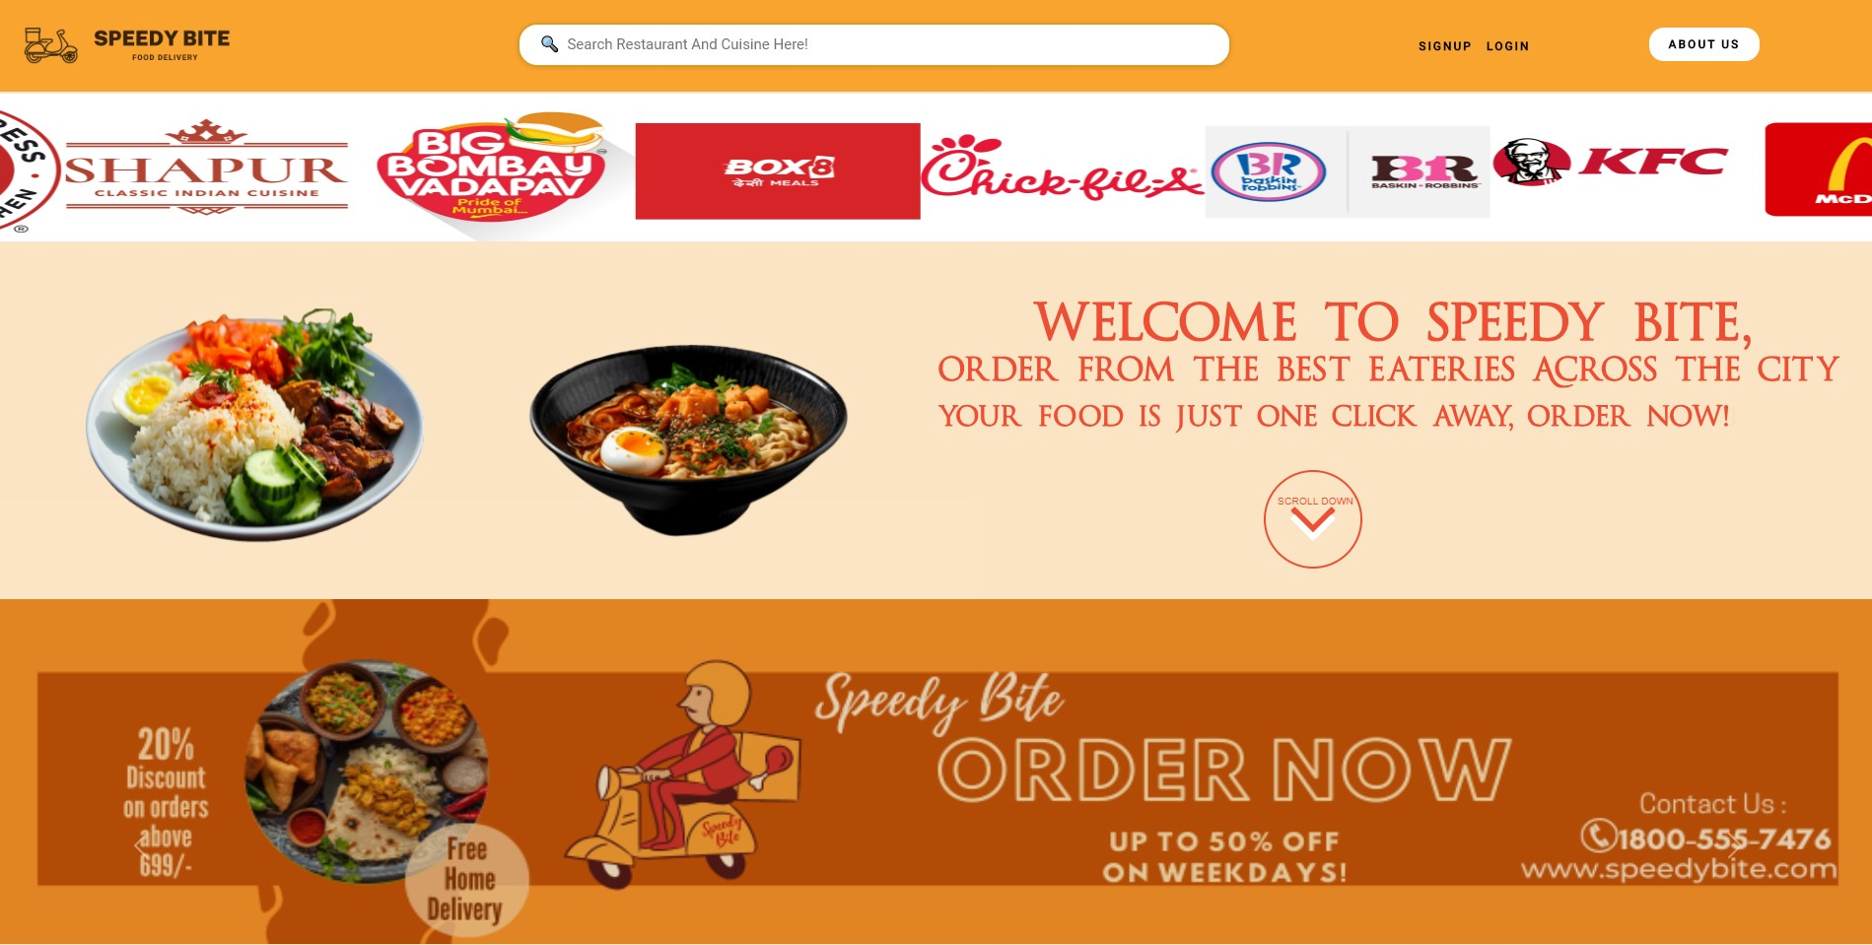
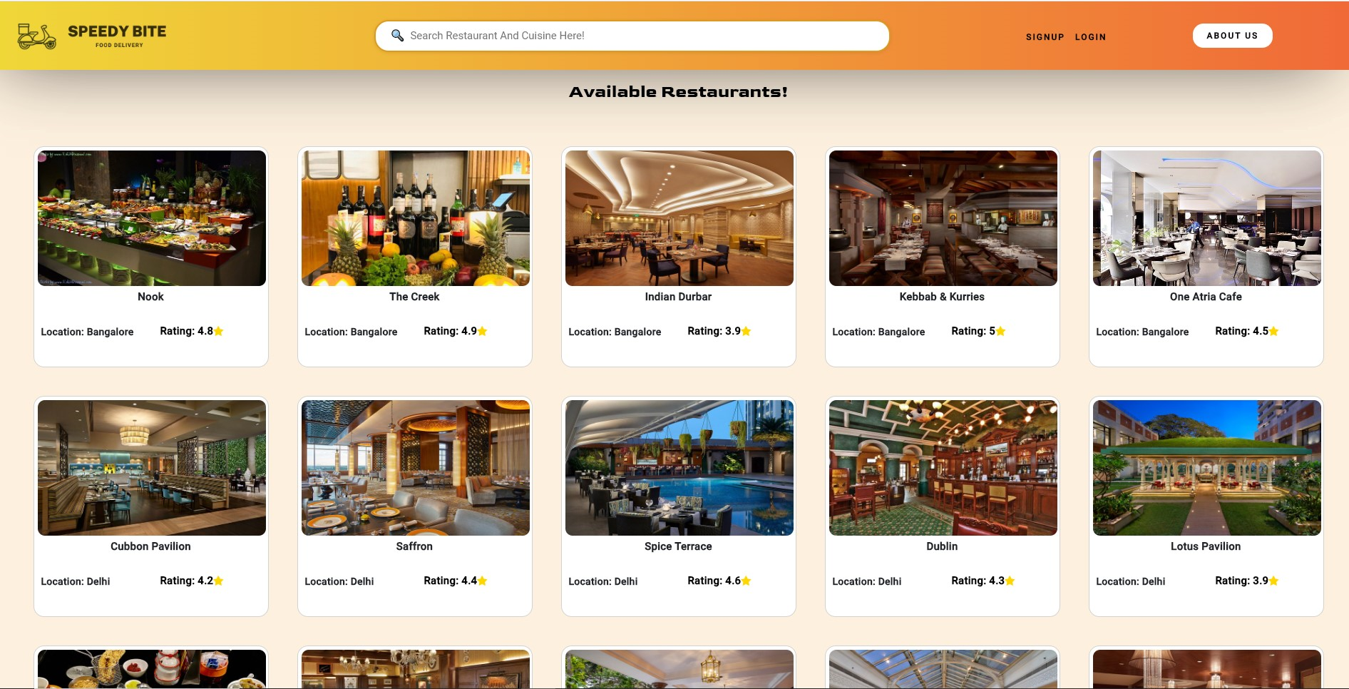
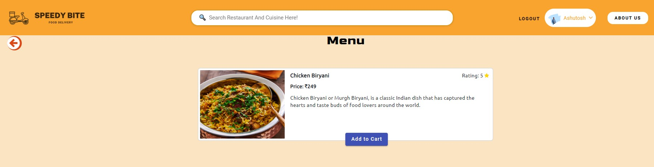
User experience

Slide 7
BACK-END MODULE
Implements Spring Boot as the web based framework of JAVA
Follows Micro-service based architecture
Micro-services included in Backend module:
1. Customer Auth (Port# 8081)
2. Customer Service (Port# 8082)
3. Restaurant Service (Port# 8083)
4. Order Service (Port# 8084)
5. Payment Service (Port# 8085)
6. Eureka Server (Port# 8761)
7. API Gateway (Port# 9000)

Slide 8
IMPORTANT FILES
Dockerfile: It is a document containing all the commands the user requires to call on the command line to assemble an image
application.yml: It is primarily used to modify configuration parameters, such as connectivity with database, port number, eureka registry etc.
pom.xml: It is used to keep a track of project details such as group ID, artifact ID, and also all the list of dependencies required
compose.yaml: It is used to run multi-container docker application.

Slide 9
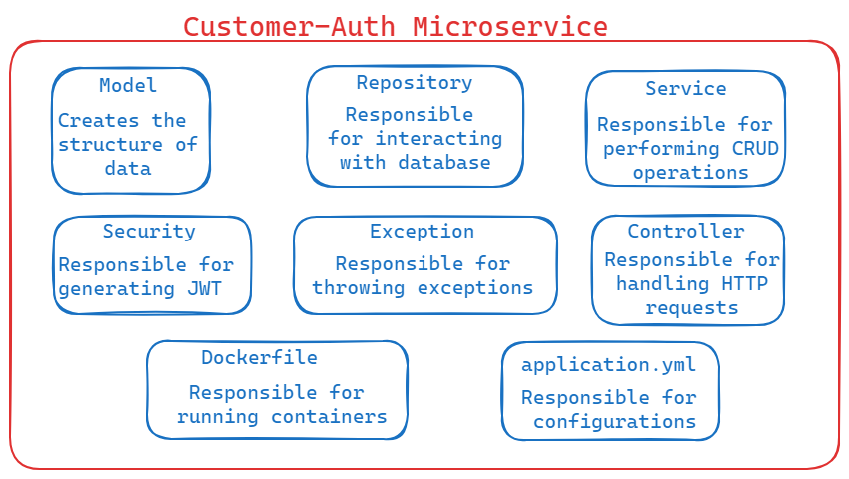
CUSTOMER AUTH
Purpose:
Allows new Users to register
Allows registered user to login
Generates a JSON Web Token (JWT), whenever a registered user logs in
Customer Details are stored in MySQL Database

Slide 10
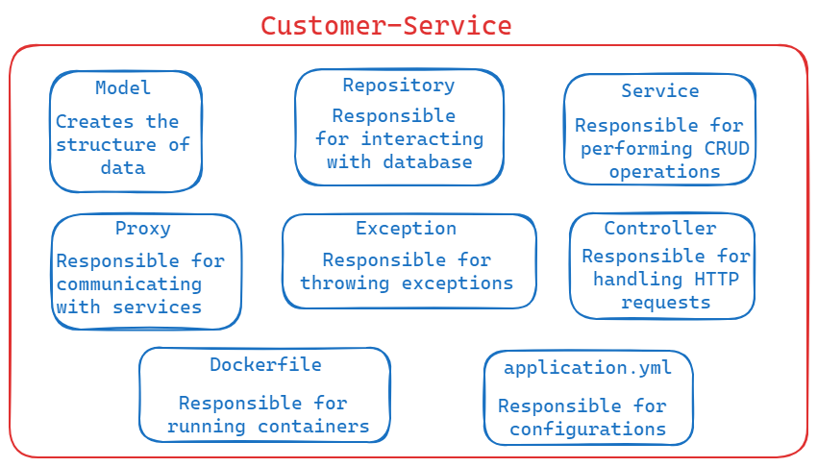
CUSTOMER SERVICE
Purpose:
Fetch customer by email or list of all customers
Update or delete customer by email
Add restaurant or view one or all restaurant for customer
Customer details are stored in Mongo DB database

Slide 11
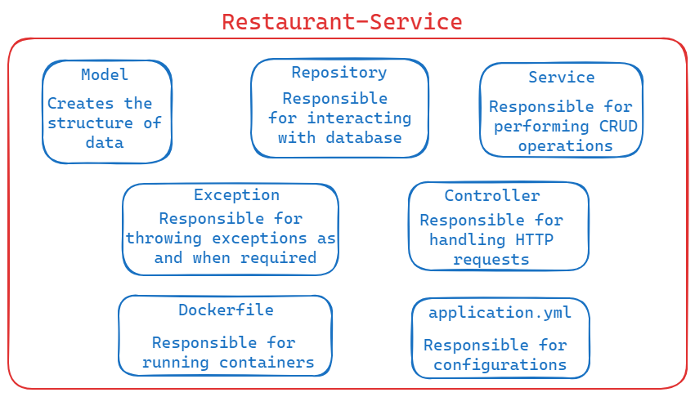
RESTAURANT SERVICE
Purpose:
Add a Restaurant and Food Item
Get one or List of all restaurants, get ratings of restaurants
Update or delete all restaurants and food item
Restaurant details are stored in Mongo DB database

Slide 12
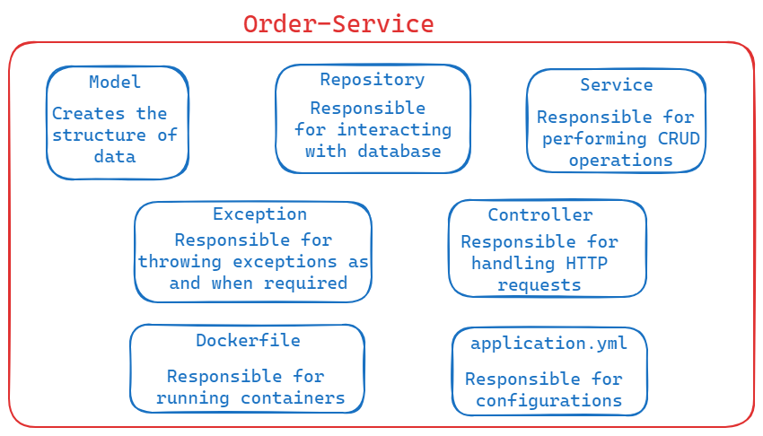
ORDER SERVICE
Purpose:
Place / Cancel an order
Update or remove any order by ID for a customer
Add, Update or Delete food item to/from an order
Fetch one or list of addresses for a customer
Order details are stored in Mongo DB database

Slide 13
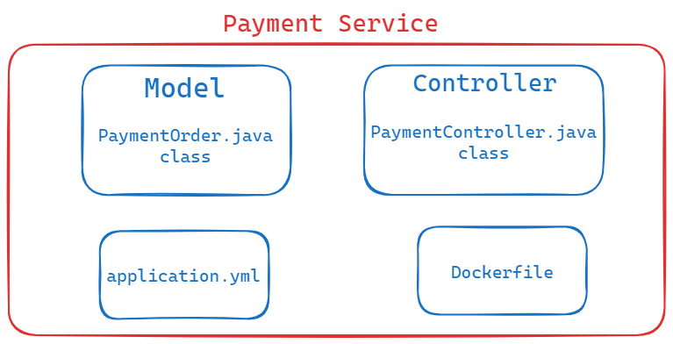
PAYMENT SERVICE
Purpose:
Place / Cancel an order
Makes use of third party payment interface such as RazorPay API

Slide 14
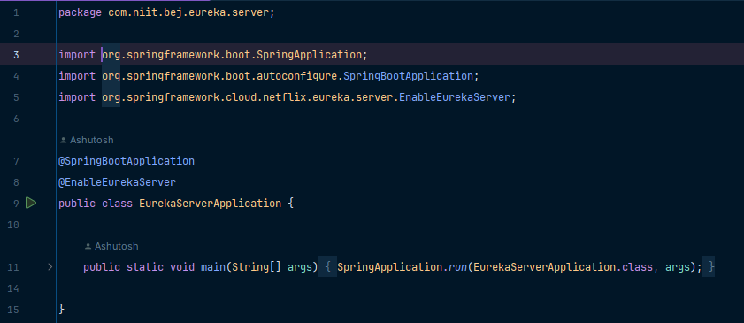
EUREKA SERVER
Purpose:
Does not register itself as a micro-service
Rather, works as service discovery
In simpler terms, keeps a track of all micro-services present in the backend module.
The annotation @EnableEurekaServer is implemented.

Slide 15
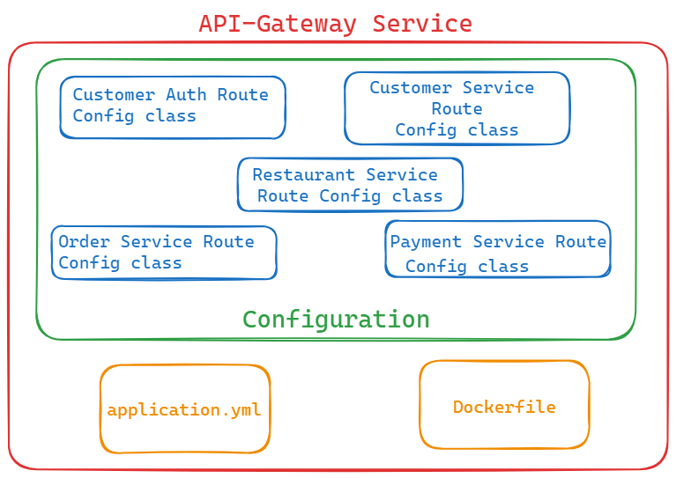
API GATEWAY
Purpose:
All requests pass through API Gateway
Provide a common port number for handling all requests
Configures the routes of all the micro services

Slide 16
FRONT-END MODULE
Developed by using Angular, a free web based JS framework
Angular is primarily used to develop Single Page Applications (SPA)
WHY ANGULAR ?
1. Custom Components
2. Dependency Injection (DI)
3. Device Compatibility & Seamless User Experience

Slide 17
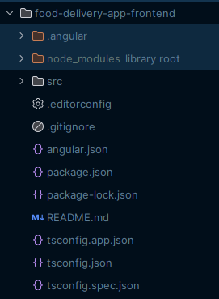
IMPORTANT FILES
angular.json: Stores information about the architecture, dependencies, build and test configurations
package.json: It is a file that contains information about the project and its dependencies
tsconfig.json: It specifies the base Typescript and Angular compiler options
app.module.ts: Maintains a track of all components and imports, required in the project
app-routing.module.ts: Specifies what component to be loaded, when a specific path is entered

Slide 18
FUTURE SCOPE…
E-Mail & SMS notifications
Live Order tracking, by adding Google Maps
Filter by location
Search functionality to filter menu, based on item name or category
Promotion of healthy food and discounts
Community engagement, sharing reviews and recommendations
Subscription service

Slide 19

Any queries

Slide 20


